Slide 1

Embedded Software Programming
Ambuj Varshney
ambujv@nus.edu.sg
Notes:
++ Thank you for inviting me to give this talk
++ In this talk, I will present a pathway that can enable us to make wireless embedded systems ubiquitous. I will describe my previous research efforts that tackle the critical challenges that limit the growth of wireless embedded systems. These are related to the growing energy asymmetry that exists between sensing, computation and communication blocks on these platforms.
++ Finally, I will conclude my talk by covering the research agenda that I would like to work on as a faculty member.

Slide 2
Course Information
Notes:
++ Over the past few years, I have designed several backscatter and beyond backscatter systems that precisely overcome these critical challenges that have limited the widespread deployment of backscatter on IoT devices.
++ The research vision that I have pursued and would like to pursue as a faculty member is to enable a massive deployment of IoT devices by bridging the energy asymmetry between sensing, computation and communication blocks by designing novel platforms and communication mechanisms. I am going to describe some of my research contributions next.

Slide 3
Important Deadlines
Event | Date
Lectures | Starting Week 1 (15th January)
Student seminar paper selection | End of recess week (10th March)
Finalising project statement | End of recess week (10th March)
Student seminars | Lectures from 18th March
Project presentation | 15th April 2024
Term paper submission | 19th April 2024
Project submission | 19th April 2024

Slide 4
Potential Systems for Discussion and Student run Seminar
Notes:
++ Over the past few years, I have designed several backscatter and beyond backscatter systems that precisely overcome these critical challenges that have limited the widespread deployment of backscatter on IoT devices.
++ The research vision that I have pursued and would like to pursue as a faculty member is to enable a massive deployment of IoT devices by bridging the energy asymmetry between sensing, computation and communication blocks by designing novel platforms and communication mechanisms. I am going to describe some of my research contributions next.

Slide 5

Reflecting FM Signals for Transmissions
Courtesy: University of Washington, Seattle
FM Backscatter: Enabling Connected Cities and Smart Fabrics, USENIX NSDI 2017

Slide 6
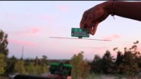
Reflecting TV Signals for Transmissions
Courtesy: University of Washington, Seattle
Ambient Backscatter: Wireless Communication Out of Thin Air, ACM SIGCOMM 2013

Slide 7
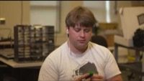
Battery-free Cellphone
Courtesy: University of Washington, Seattle
Battery-free Cellphone, IMWUT/UBICOMP 2018

Slide 8

Farmbeats: Sensors and IoT for Agriculture
FarmBeats: An IoT Platform for Data-Driven Agriculture, USENIX NSDI 2017
Notes:
++ We may all have heard of the term Internet of Things. So how are these wireless embedded systems related to the Internet of Things: Today, IoT includes a broad class of devices, including powerful platforms such as smartphones. However, it also includes more resource-constrained devices and what we call Wireless Embedded Systems, and in fact, I consider it to be one of the essential parts of the IoT ecosystem.
++ These are platforms equipped with a radio transceiver, sensor, microcontroller, and some form of energy storage. These platforms also often form a network, and sensor network as it is called has been an active area of research for the past two decades.
++ The research community has also developed wireless embedded platforms which we may know about, and these include: CMUCAM, which is an image sensor platform developed at Carnegie Mellon University, or Permamote is long life sensor platform from the lab I am associated with at UC Berkeley or Lorea which is a long-range backscatter platform that I had developed as part of my doctoral dissertation at Uppsala University. All of these are an example of Wireless Embedded Systems.

Slide 9
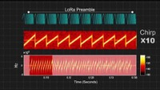
Low-Power, Long-Range, Battery-free LoRa
PLoRa: A Passive Long-Range Data Network from Ambient LoRa Transmissions, ACM SIGCOMM 2018

Slide 10

Actuation is energy expensive (wrt sensing)
Wind dispersal of battery-free wireless devices, Nature March 2022
Notes:
First, we look at the computational elements, and these consist of a microcontroller or an FPGA. Today, we find that these computational elements consume at least one order of magnitude higher power consumption when compared to the commonly used sensors.
However, we also find that microcontrollers are increasingly becoming energy efficient. We investigate a typical microcontroller that has been used in sensor platforms over the past two decades. We find that energy efficiency has improved by almost two orders of magnitude. Some of the present-generation microcontrollers, such as Ambiq Apollo4 consume just 3 uA/MHz than 330 uA for MSP430 used on platforms such as TelOS B.
If the trend continues, we can expect the microcontrollers to catch up with the sensors and become energy-efficient. This significant improvement is that the digital components are increasing becoming efficient as they follow moore’s law.

Slide 11

Generating WiFi transmissions via backscatter
Wind dispersal of battery-free wireless devices, Nature March 2022
Notes:
Backscatter communication actually help us overcome this limitation

Slide 12

Battery-free Gameboy
Battery-Free Game Boy, ACM IMWUT 2020
Notes:
++ We may all have heard of the term Internet of Things. So how are these wireless embedded systems related to the Internet of Things: Today, IoT includes a broad class of devices, including powerful platforms such as smartphones. However, it also includes more resource-constrained devices and what we call Wireless Embedded Systems, and in fact, I consider it to be one of the essential parts of the IoT ecosystem.
++ These are platforms equipped with a radio transceiver, sensor, microcontroller, and some form of energy storage. These platforms also often form a network, and sensor network as it is called has been an active area of research for the past two decades.
++ The research community has also developed wireless embedded platforms which we may know about, and these include: CMUCAM, which is an image sensor platform developed at Carnegie Mellon University, or Permamote is long life sensor platform from the lab I am associated with at UC Berkeley or Lorea which is a long-range backscatter platform that I had developed as part of my doctoral dissertation at Uppsala University. All of these are an example of Wireless Embedded Systems.

Slide 13
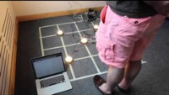
Trilateration using beacons sent using light
Ye-Sheng Kuo, Pat Pannuto, Ko-Jen Hsiao, and Prabal Dutta. 2014. Luxapose: indoor positioning with mobile phones and visible light. In Proceedings of the 20th annual international conference on Mobile computing and networking (MobiCom '14)

Slide 14
Roadmap of the lecture today
Let us recall what was covered in the last lecture
Microcontrollers
Storage
Bus: SPI and I2C
Example of library support in Arduino
Notes:
Here is the roadmap of the major topics that I am going to cover during the presentation. We have already covered the exponential growth of the internet of things; next, I will talk about the critical energy challenge that can severely hinder this massive growth and preventing us from realising this immense economic value enabled by the IoT.

Slide 15
Let us recall what we covered in the last lecture
Notes:
++ Over the past few years, I have designed several backscatter and beyond backscatter systems that precisely overcome these critical challenges that have limited the widespread deployment of backscatter on IoT devices.
++ The research vision that I have pursued and would like to pursue as a faculty member is to enable a massive deployment of IoT devices by bridging the energy asymmetry between sensing, computation and communication blocks by designing novel platforms and communication mechanisms. I am going to describe some of my research contributions next.

Slide 16
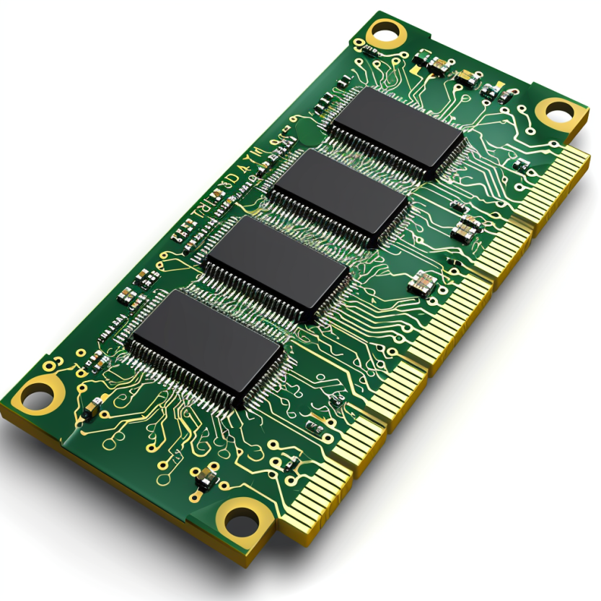
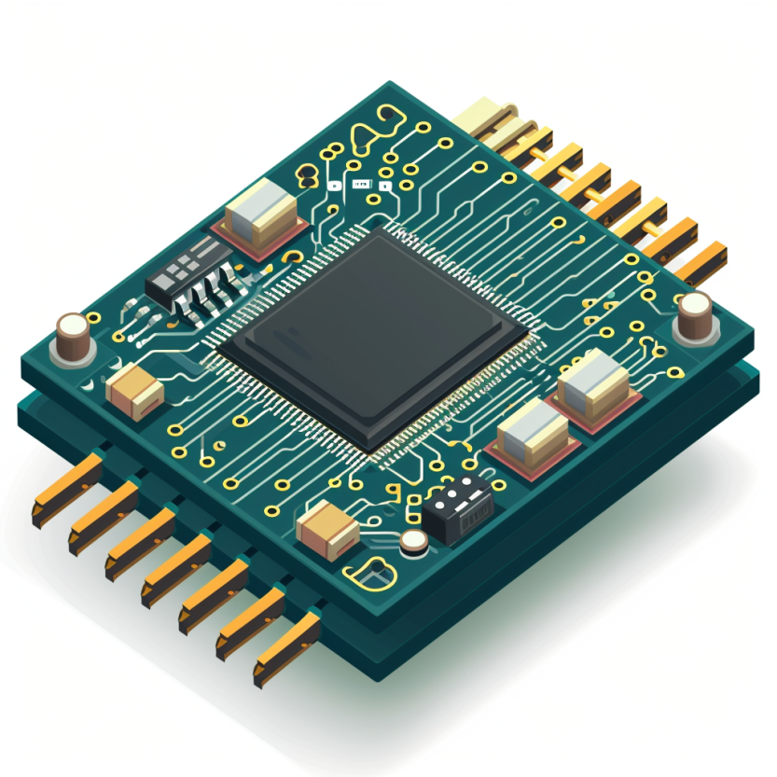
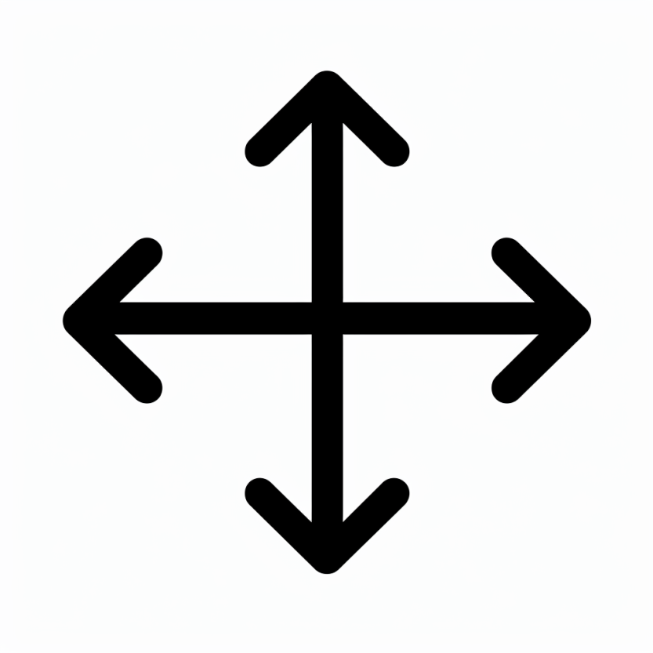
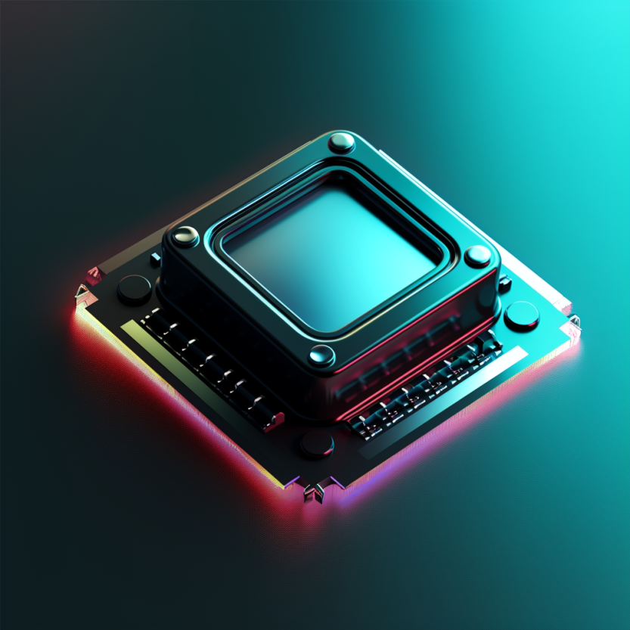

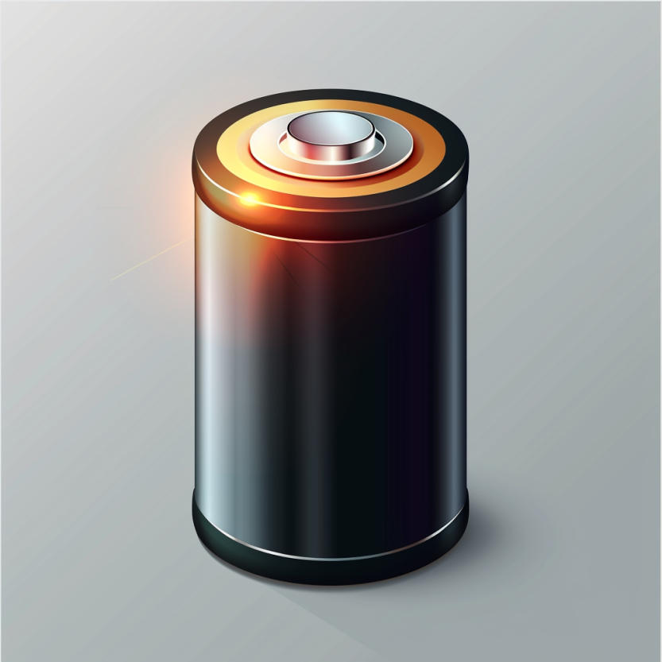
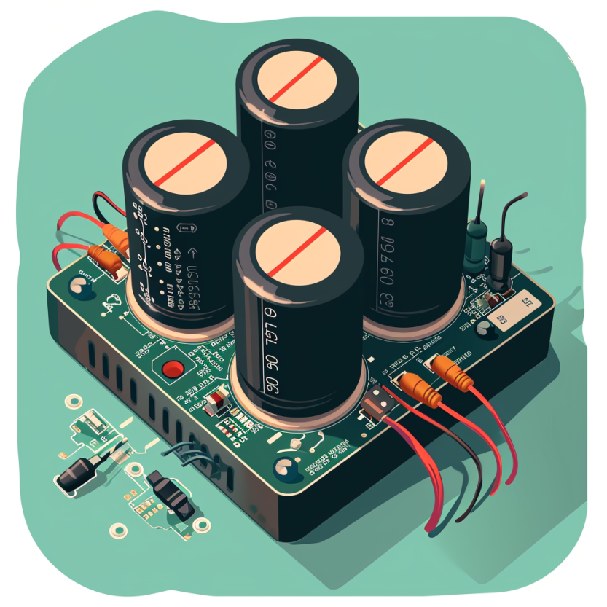
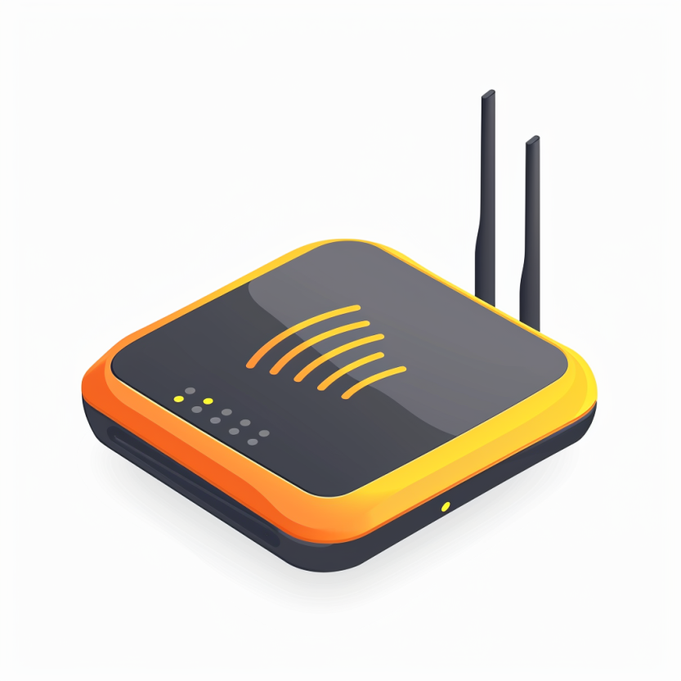

Four main tasks performed by an embedded device
Computation and Storage
Sensing and Actuation
Power
Management
Wireless Networking
Notes:
First, we look at the computational elements, and these consist of a microcontroller or an FPGA. Today, we find that these computational elements consume at least one order of magnitude higher power consumption when compared to the commonly used sensors.
However, we also find that microcontrollers are increasingly becoming energy efficient. We investigate a typical microcontroller that has been used in sensor platforms over the past two decades. We find that energy efficiency has improved by almost two orders of magnitude. Some of the present-generation microcontrollers, such as Ambiq Apollo4 consume just 3 uA/MHz than 330 uA for MSP430 used on platforms such as TelOS B.
If the trend continues, we can expect the microcontrollers to catch up with the sensors and become energy-efficient. This significant improvement is that the digital components are increasing becoming efficient as they follow moore’s law.

Slide 17
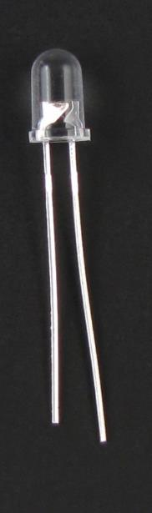
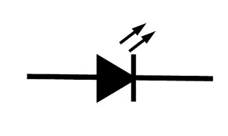
Light emitting diodes (LEDs)
Directional component: only allows current to flow one way
Shorter side is the negative one
i.e. where current flows to
Larger metal component
inside of case or case flat spot is cathode or
negative (-) lead
Shorter wire is cathode or
negative (-) lead
Negative ( - ) lead
Schematic Symbol
Notes:
Light Emitting Diodes (LEDs) are vital actuators for embedded and Internet of Things (IoT) devices. They provide a visual indication of the device's state and can also be used for debugging purposes. LEDs are directional components that allow current to flow in one direction only.
Typically, the cathode, where the current flows, is the shorter side of the LED. LEDs are an effective way to indicate the status of a device and provide feedback during the development and testing phase.
They are also commonly used in consumer electronics and lighting applications.

Slide 18
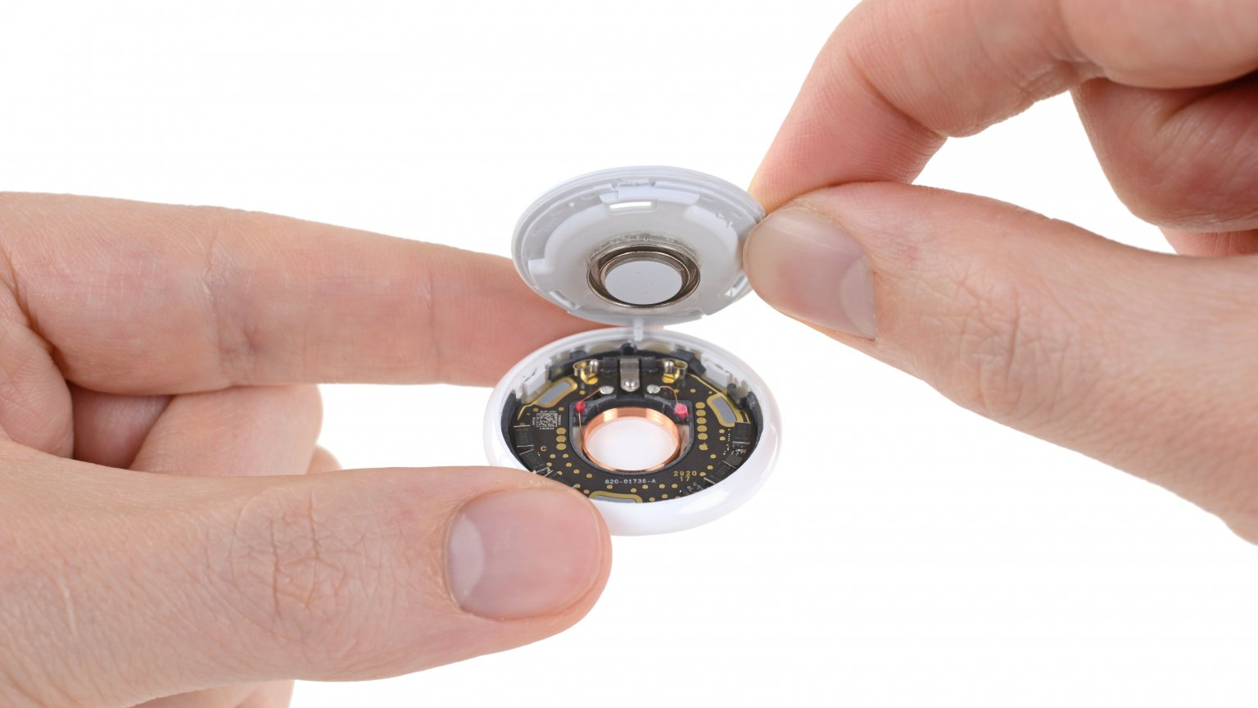
What’s inside Apple AirTag
Accelerometer: Bosch Sensortec BMA28x 3-axis accelerometer
SoC/Microcontroller: Nordic Semiconductor nRF52832 Bluetooth low-energy SoC w/NFC controller
Actuator: Speaker
And many other componets….
Notes:
Backscatter communication actually help us overcome this limitation

Slide 19
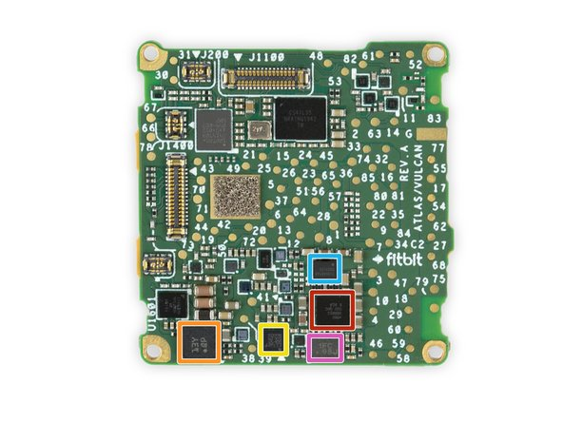
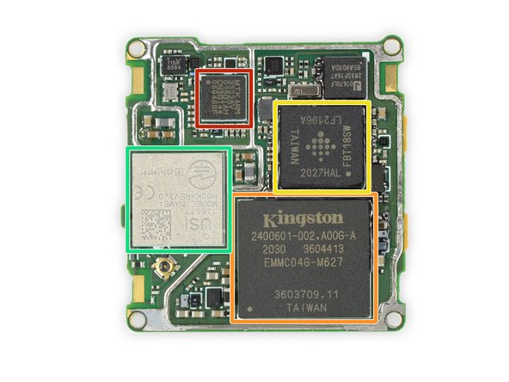
Let’s look at some commonly used IoT devices
MediaTek MT3333 GPS SoC
Bosch Sensortec BHI160 Accelerometer/Gyroscope w/ Sensor Hub
STMicroelectronics LIS2DW12 MEMS 3-Axis Accelerometer
Fitbit FBT18SW ARM application processor
Notes:
Backscatter communication actually help us overcome this limitation

Slide 20
General Purpose Input/Output (GPIO)
Read/write from/to external pins on the microcontroller
Two possible values: high (1) or low (0)
Basic unit of operation for microcontrollers
Allows them to interact with buttons and LEDs
Every microcontroller has GPIO

Slide 21
DAC applications
What do you use an analog output for?
Audio output
But it needs to be high quality (resolution and speed)
Motors
But only with a controller that actually drives them with enough current
LED brightness

Slide 22
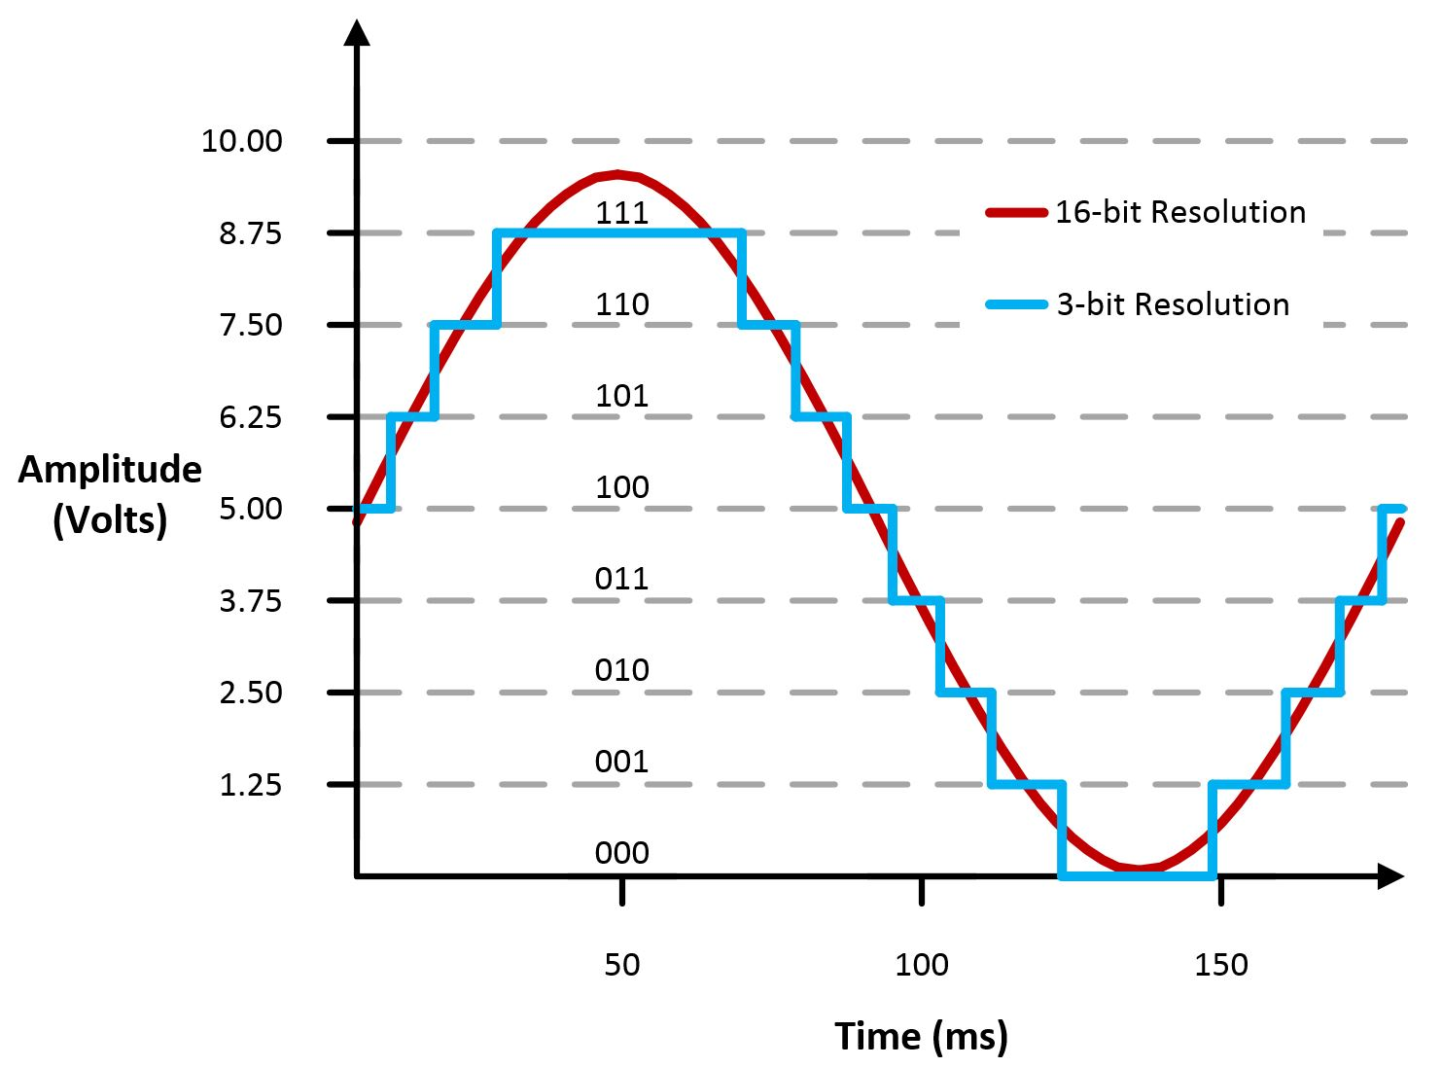
Digital-to-Analog Converters
Generates an analog voltage
DACs are conceptually the inverse of ADCs
Number of bits of resolution choose analog step size
Frequency determines step duration

Slide 23
High resolution versus high frequency
What role does each play in a DAC? Which is more important?
High resolution can accurately represent a voltage
High frequency can accurately represent a changing voltage
In practice:
Need high enough resolution, then as high of frequency as possible

Slide 24
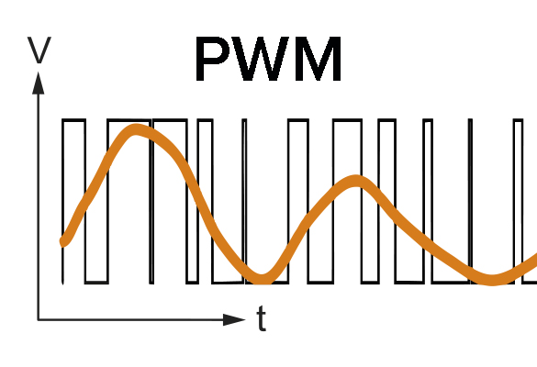
Pulse-Width Modulation
Much easier to control high or low than an analog output
Idea: modify how long a signal is high within some switching frequency, a.k.a duty cycle
On 50% of the time for half voltage
On 10% of the time for tenth voltage
Duty cycle, not frequency!

Slide 25
Every microcontroller can do PWM
Not every microcontroller has a PWM peripheral
But every microcontroller has timers and digital outputs
But all that is need is a GPIO and a Timer (or two)
Timer determines when to turn GPIO on and off
Often can be automated in hardware rather than use interrupt handler

Slide 26
PWM applications
Servos
Duty cycle chooses angle
Motor controllers
Duty cycle chooses current and therefore speed
LED brightness
And “breathing” effect
Audio
Can sound okay if frequency is high enough

Slide 27
Controlling timing in wired communication
Synchronous communication
Clock signal sent along with data
Data is captured at edge of clock signal (rising or falling)
Advantage: send signals very fast
Disadvantage: extra pin and wire
Asynchronous communication
Agree upon timing in advance and read data at that rate
Advantage: no need for clock signal
Disadvantage: clock synchronization
Transmitter
Receiver
b0
b1
b2
b3
b4
b5
b6
b7
DATA
CLK
Transmitter
Receiver
b0
b0
b0
b0
b0
b0
D0
b1
D1
b2
D2
b3
D3
b4
D4
b5
D5
b6
D6
b7
D7
CLK

Slide 28

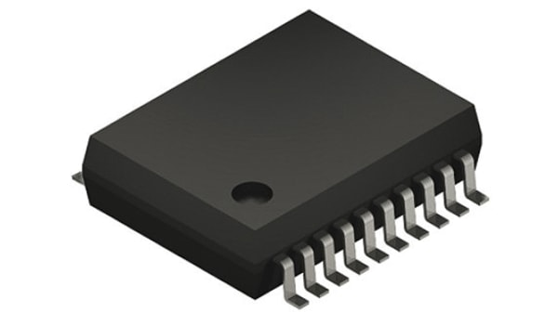
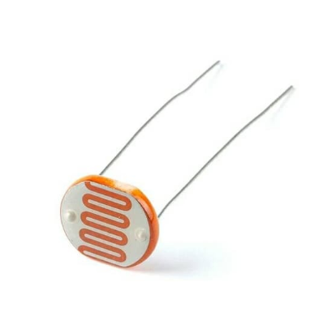
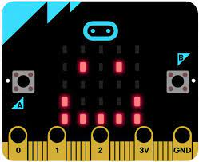
Microcontrollers often adopt star networks

Slide 29
Universal Asynchronous Receiver Transmitter
Serial communication between two devices
Two wires: transmit and receive
Simple to implement and very common on microcontrollers
Tradeoff choices: Serial, Low speed, Asynchronous, Point-to-Point
Most frequently used to send text data between devices
Microcontroller printf() output
Radio AT commands to/from microcontroller

Slide 30
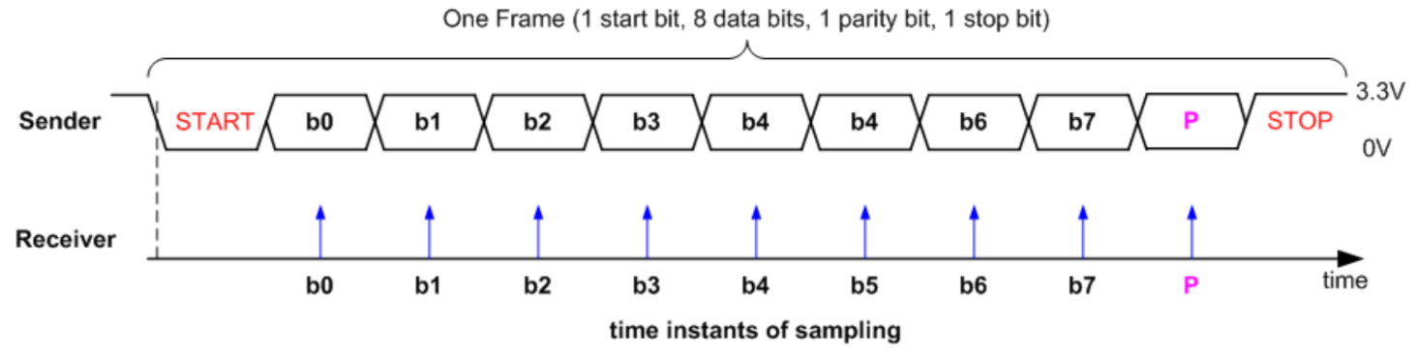
Data frame for UART protocol
Signal is high by default
Goes low to trigger Start
Send each data bit (high=1, low=0), plus optionally parity bit
Goes high to trigger Stop

Slide 31
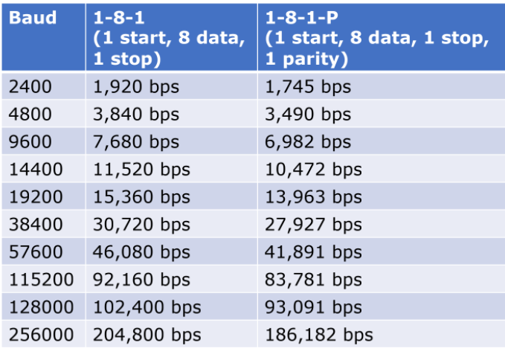
Baud rate for UART communication
Baud rate is a measure of “symbols per second”
Typically 1 bit per symbol, but not always
UART is 1 bit per symbol, but 8 data bits per 10/11 symbols
Any baud rate is possible
But there are a handful of normal configurations
115200 and 9600 are common

Slide 32
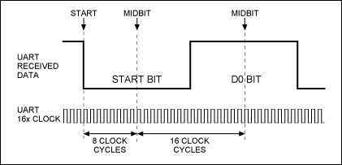
UART sampling rate
How do we make asynchronous communication work?
Both sides must agree on the baud rate
Listen for start bit
Conceptually:
Only need to sample 9-10 more times at baud rate spacing
Short enough that clocks should diverge too much
Realistically:
Sample 8 or 16 times per bit
Determine boundaries between bits
Select most common value between boundaries

Slide 33
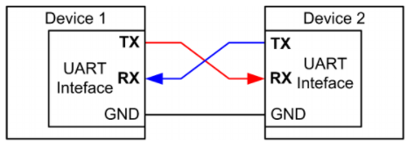
UART: chip-to-chip communication
Usually implemented as a two-wire interface
TXD: Transmits data
RXD: Receives data
Optionally two additional pins for flow control
No clock signal! Asynchronous
Note: TX connects to RX

Slide 34
Detecting errors with parity
Choose one configuration for all UART messages
Even parity: total number of “1” bits in data is even
Odd parity: total number of “1” bits in data is odd
Parity bit: set to 1 or 0 to guarantee the parity configuration
If message doesn’t match parity configuration at receiver, there was a bit error (single error detecting)
Example: Data = 10101011 (five “1” bits)
Odd parity: set parity bit to zero
Even parity: set parity bit to one

Slide 35
What are error conditions for UART?
Parity failure
Bit error when receiving data
Overrun
New data arrived and overwrote buffer in peripheral before it was read
Framing
Did not see Stop Bit when expected (should be guaranteed “1”)
Break condition
Signal is low for entire message (Zero data plus Framing Error)
Often used as a signal between devices

Slide 36
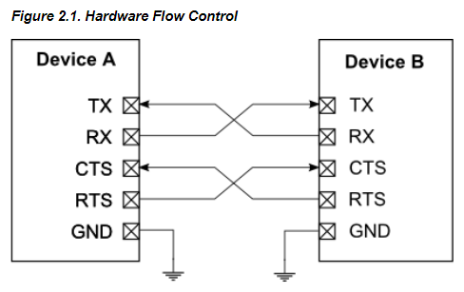
Flow control for databits
How do we ensure that the other device is ready for the message?
Add two pins for “hardware flow control”
Ready To Send (RTS) output, signals that you want to send data
Clear to Send (CTS) input, signals that other device is ready to receive
Software flow control is possible
Send special byte that means pause or resume transmissions

Slide 37
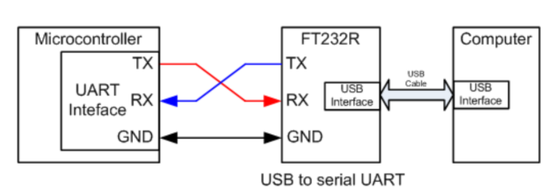
How to allow UART to communicate to computer?
FTDI makes the most common chip to do this (FT232)
Microbit uses a microcontroller to do this!
KL27Z connects to USB
Also connects to nRF52833 via UART and JTAG
ttyACM0 is a “virtual serial device” on top of USB, miniterm is a serial console

Slide 38
UART Pros and Cons
Pros
Only uses two wires
No clock signal is necessary
Can do error detection with parity bit
Cons
Data frame is limited to 8 bits (20% signaling overhead)
Doesn’t support multiple device interactions (point-to-point only)
Relatively slow to ensure proper reception

Slide 39
Roadmap of the lecture today
Let us recall what was covered in the last lecture
Microcontrollers
Storage
Bus: SPI and I2C
Example of library support in Arduino
Notes:
Here is the roadmap of the major topics that I am going to cover during the presentation. We have already covered the exponential growth of the internet of things; next, I will talk about the critical energy challenge that can severely hinder this massive growth and preventing us from realising this immense economic value enabled by the IoT.

Slide 40
Computation and Storage
Notes:
++ Over the past few years, I have designed several backscatter and beyond backscatter systems that precisely overcome these critical challenges that have limited the widespread deployment of backscatter on IoT devices.
++ The research vision that I have pursued and would like to pursue as a faculty member is to enable a massive deployment of IoT devices by bridging the energy asymmetry between sensing, computation and communication blocks by designing novel platforms and communication mechanisms. I am going to describe some of my research contributions next.

Slide 41
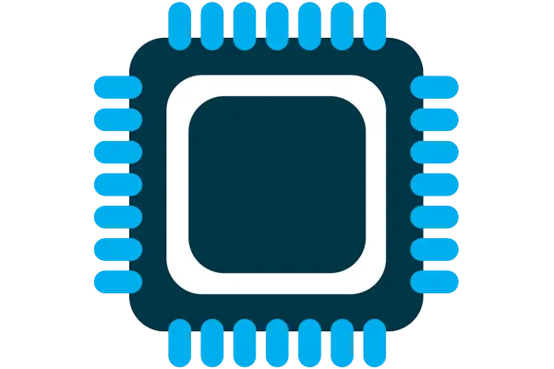
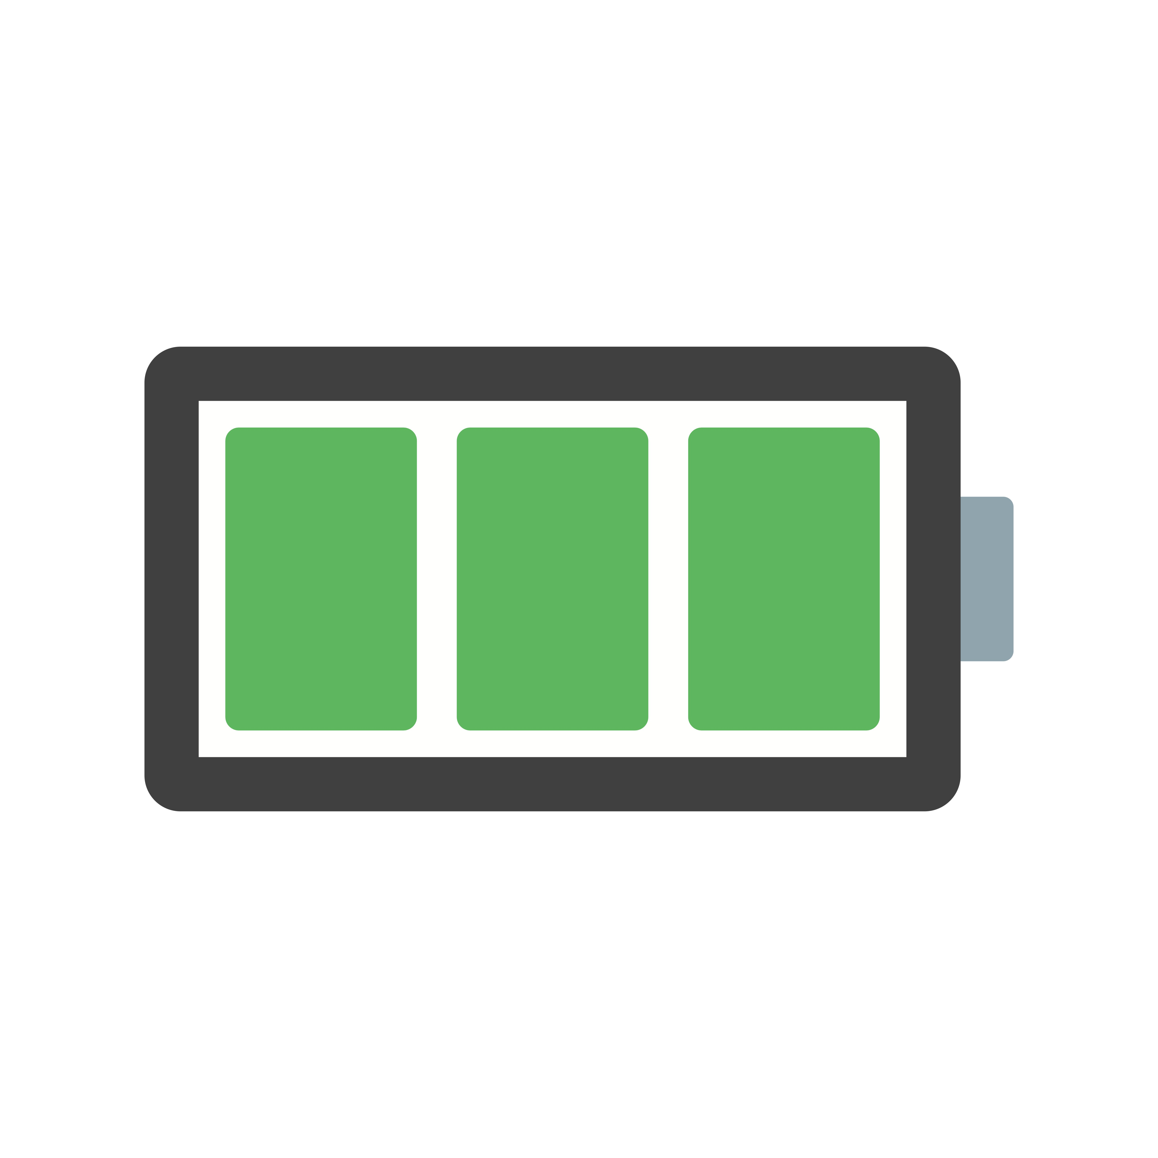


What are components of internet of things
Computation and Storage
Sensing and Actuation
Power
Wireless Connectivity
Notes:
First, we look at the computational elements, and these consist of a microcontroller or an FPGA. Today, we find that these computational elements consume at least one order of magnitude higher power consumption when compared to the commonly used sensors.
However, we also find that microcontrollers are increasingly becoming energy efficient. We investigate a typical microcontroller that has been used in sensor platforms over the past two decades. We find that energy efficiency has improved by almost two orders of magnitude. Some of the present-generation microcontrollers, such as Ambiq Apollo4 consume just 3 uA/MHz than 330 uA for MSP430 used on platforms such as TelOS B.
If the trend continues, we can expect the microcontrollers to catch up with the sensors and become energy-efficient. This significant improvement is that the digital components are increasing becoming efficient as they follow moore’s law.

Slide 42
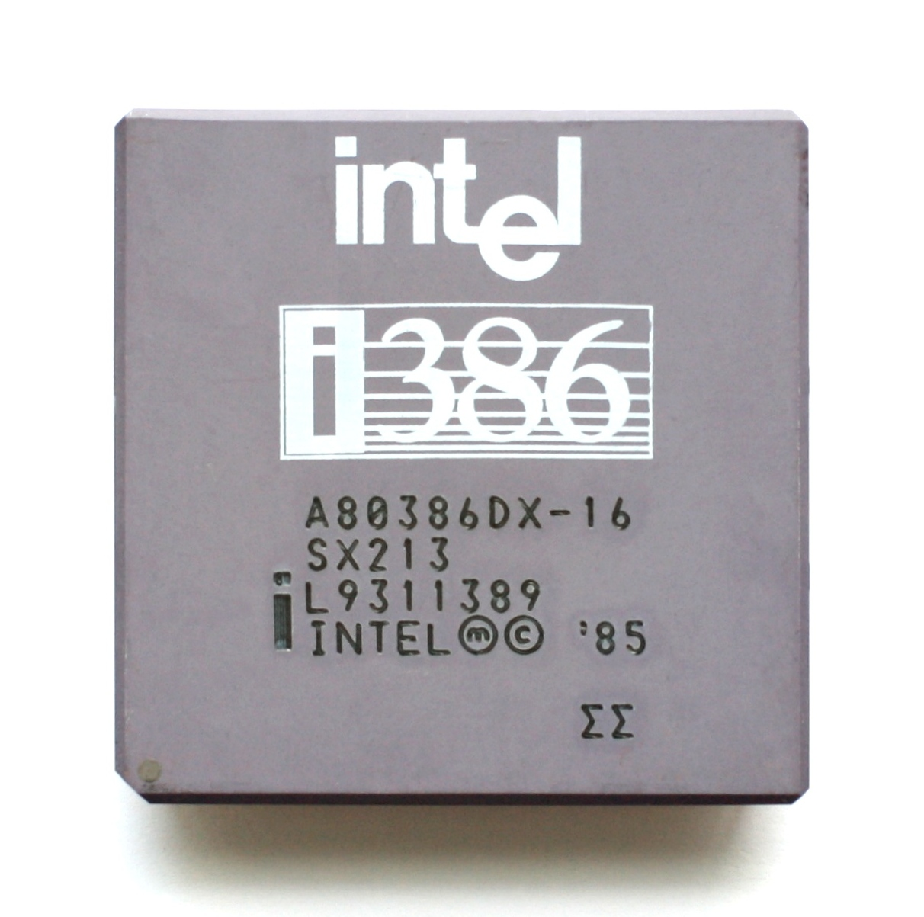
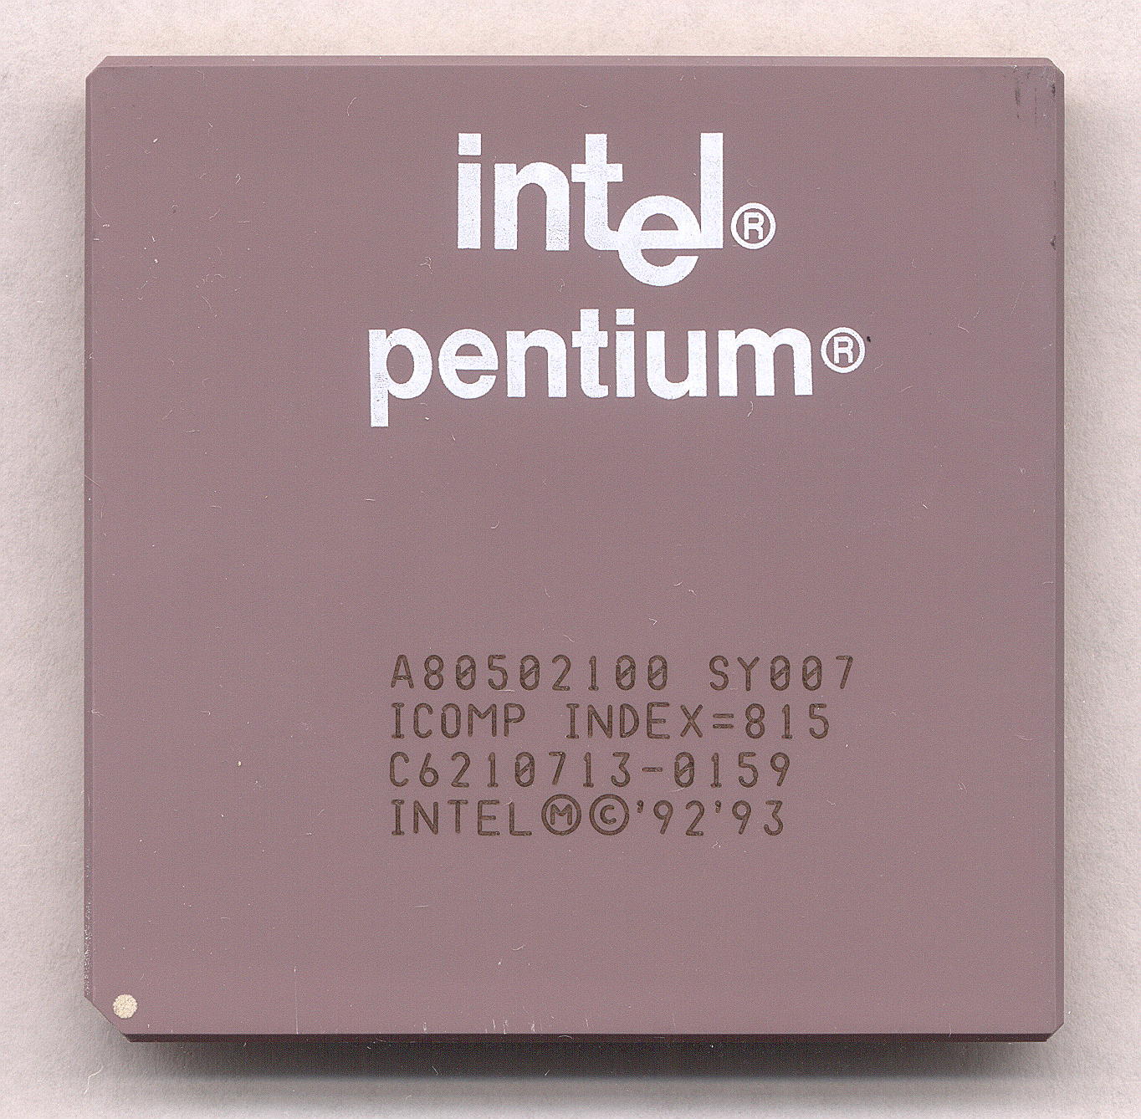
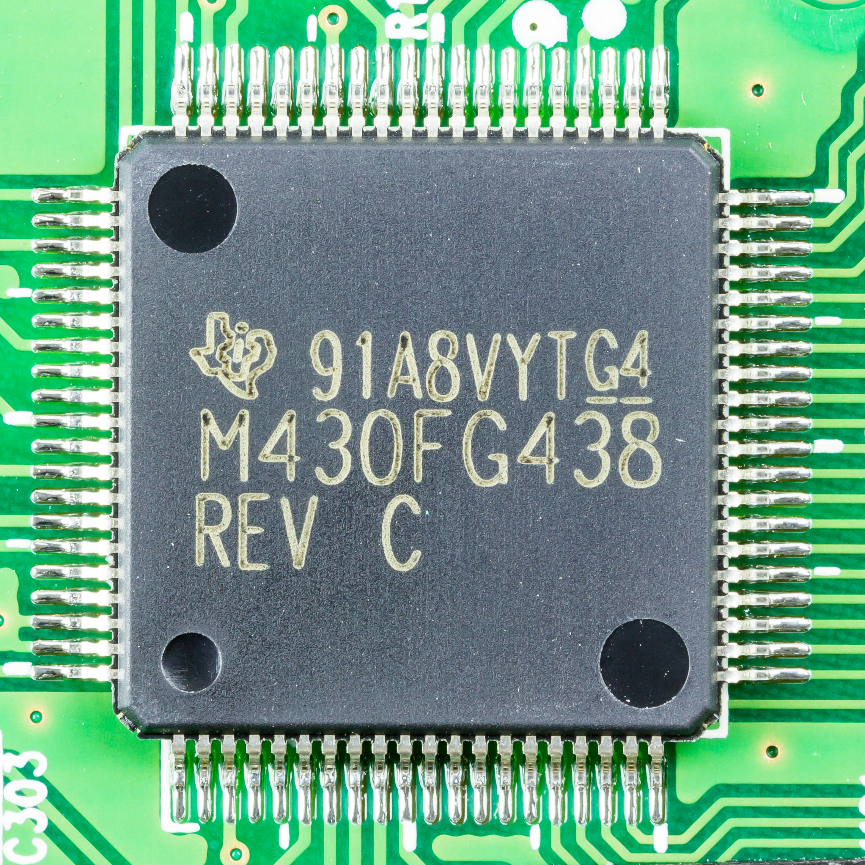
What is heart of computers and internet of things
Microprocessor (Computers)
They usually don’t have peripherals or memory
CPU + Pins (No memory, peripherals)
Your computer typically has a microprocessor
Microcontrollers (Internet of Things)
Memory + Peripherals + CPU + Pins
Peripherals: Specialized hardware units within the chip
Notes:
Backscatter communication actually help us overcome this limitation

Slide 43
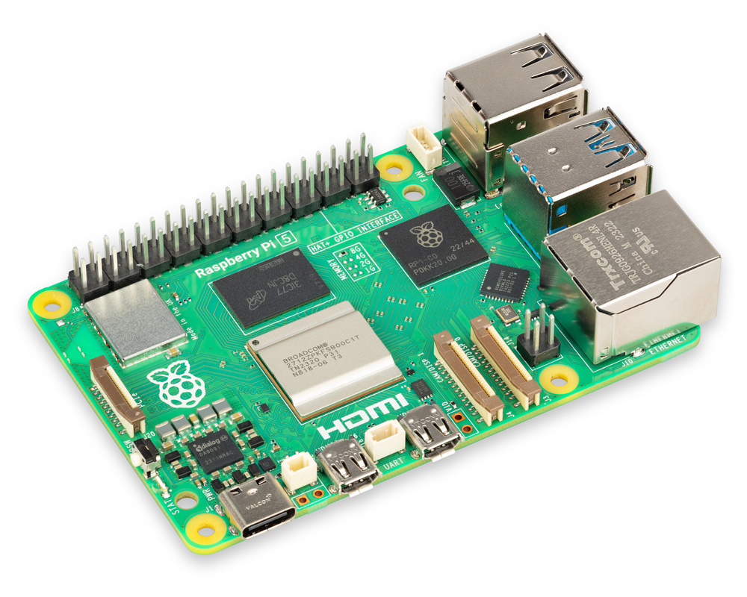
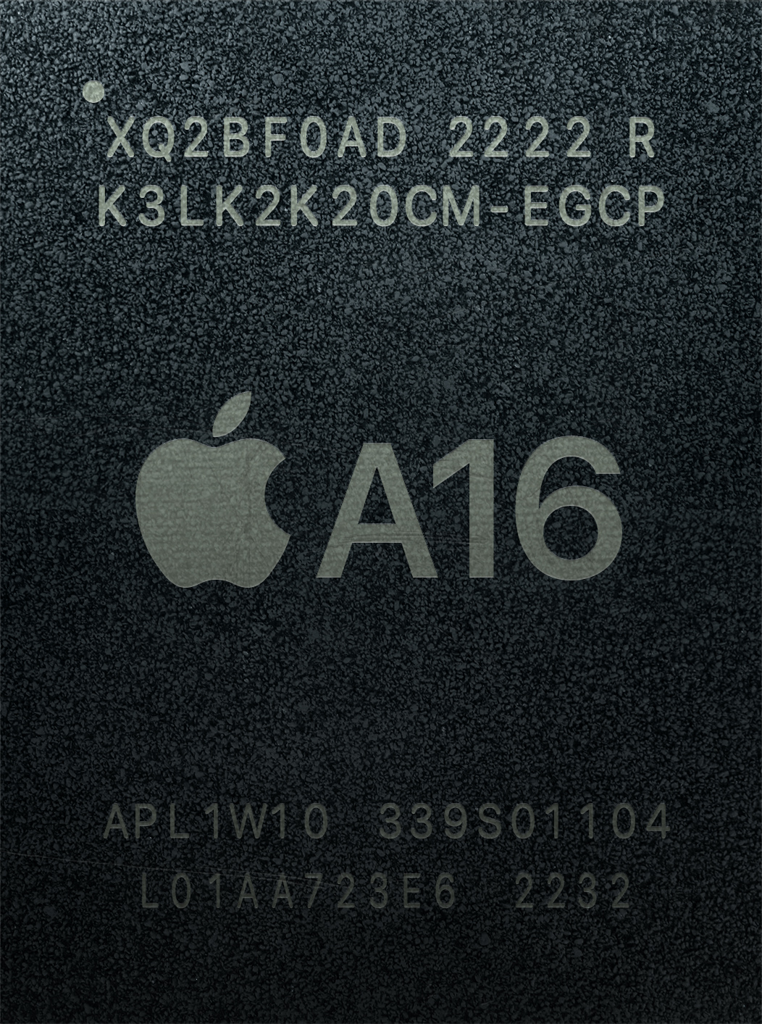
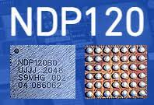
What is heart of computers and internet of things
System on chips (SoC)
Microcontroller + Extensive Peripherals
Essentially multiple chips combined
Example: Radios, ML accelerators in a single chip
Dedicated accelerator chips
Designed for a specific purpose like for speech detection
Notes:
Backscatter communication actually help us overcome this limitation

Slide 44
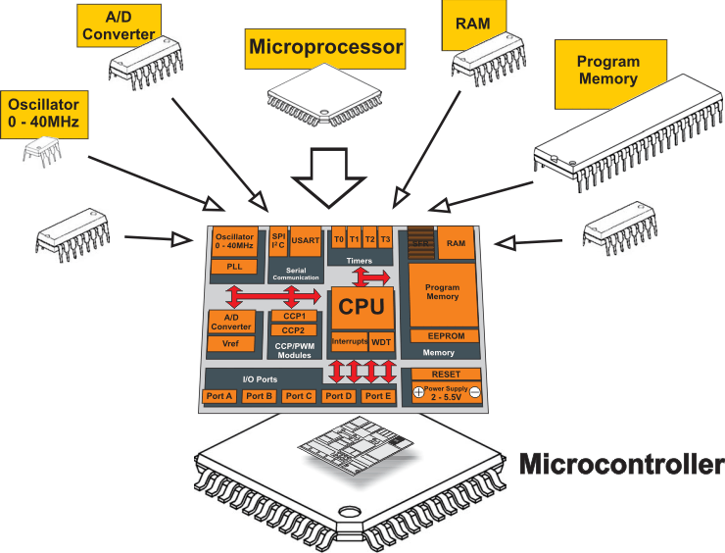
What is a microcontroller? Microprocessor + Peripherals + Memory + Pins + ?
Microcontroller
Processor
Peripherals
Pins
Memory
Notes:
Backscatter communication actually help us overcome this limitation

Slide 45
An image of the die of a microcontroller

Slide 46
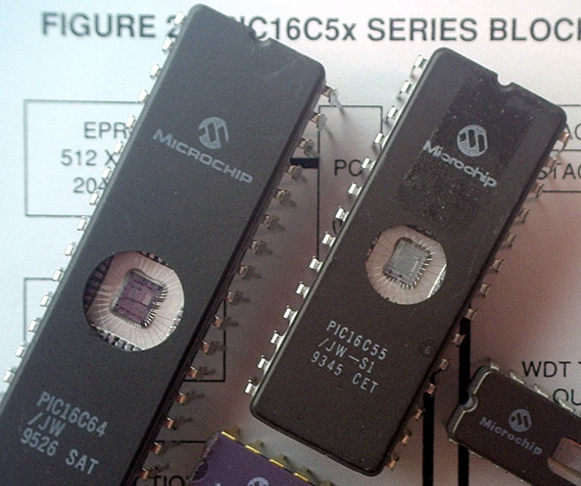
Some example of older microcontrollers
Cheap , small computer systems
PIC
8, 16, and 24-bit MIPs architecture
PICAXE available with Basic interpreter
AVR
8-bit custom architecture (AVR architecture)
Used in Arduinos
AT Tiny 4: $0.30 per unit
4 I/O pins, 32 Bytes RAM, 512 Bytes ROM

Slide 47
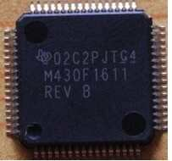
More capable microcontrollers (00s-10s)
Diversify into extreme low power and more capable systems
MSP430
16-bit custom architecture (MSP430 architecture)
Capable, but also extremely low power
<1 μA sleep current
STM32, Atmel SAM series (Cortex-M0, M3, M4, M4F)
32-bit ARM architecture (ARMv7)
Leverage success of ARM on smartphones
Every peripheral under the sun. Plus a variety of memory choices

Slide 48
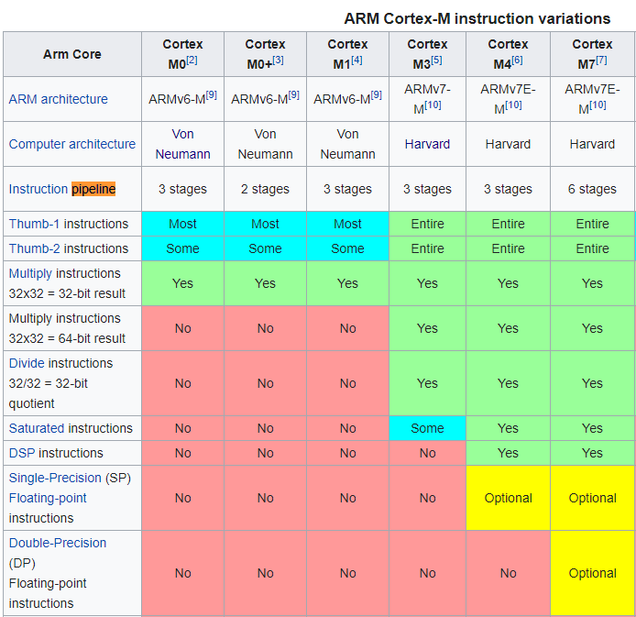
ARM Cortex M Series
A number of options for increasing capabilities
In practice:
Cortex-M0+ for low-end systems
Coretx-M4 for high capability systems

Slide 49
Modern system-on-chips (10s-?)
Focus: increase memory and capability
Include radios in the same chip
Machine learning accelerators and other dedicated functionality
nRF51 and nRF52 series
32-bit ARM microcontrollers (Cortex M)
Include 2.4 GHz radio: Bluetooth Low Energy and 802.15.4/Thread
Others have followed this same path
TI CC26XX
Apollo3
STM32WL

Slide 50
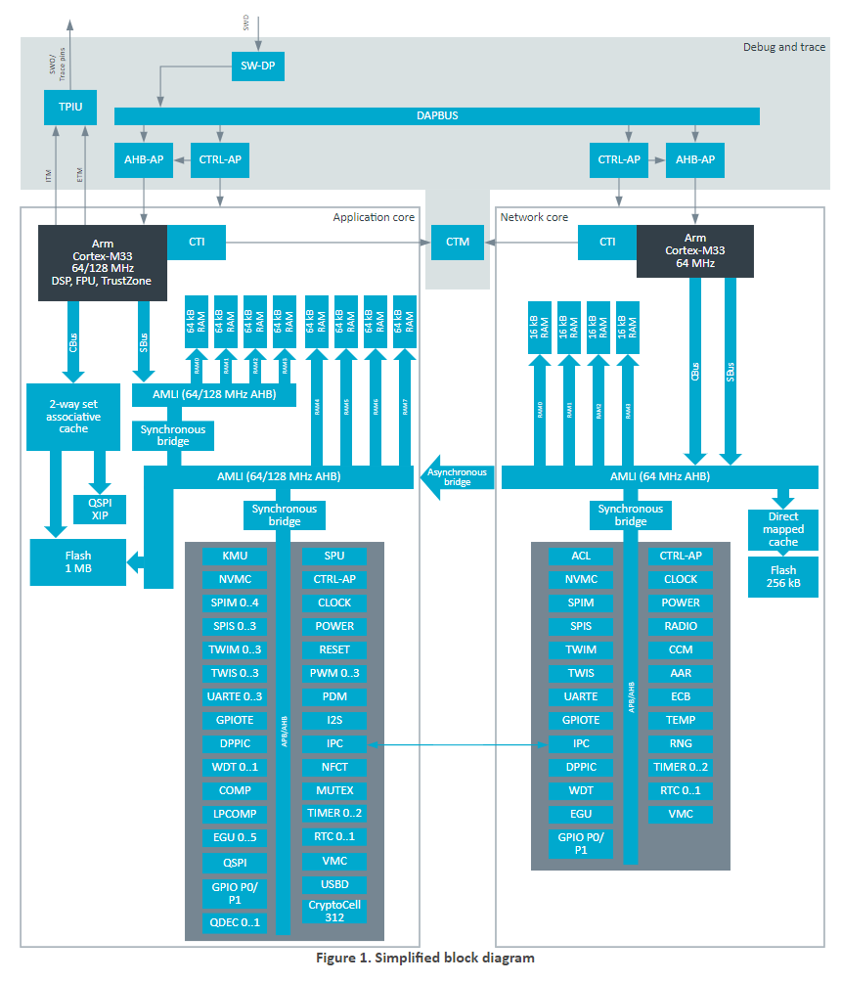
What are trends for future microcontrollers
Multi-core systems
Not for performance, but for separation of concerns
Run radio code on one core
Application code goes on the other core
Also allows BIG.little architecture
Higher performance core when interpreting data
Lower performance core for sampling sensors
nRF53 series is already doing this
But support is still nascent

Slide 51
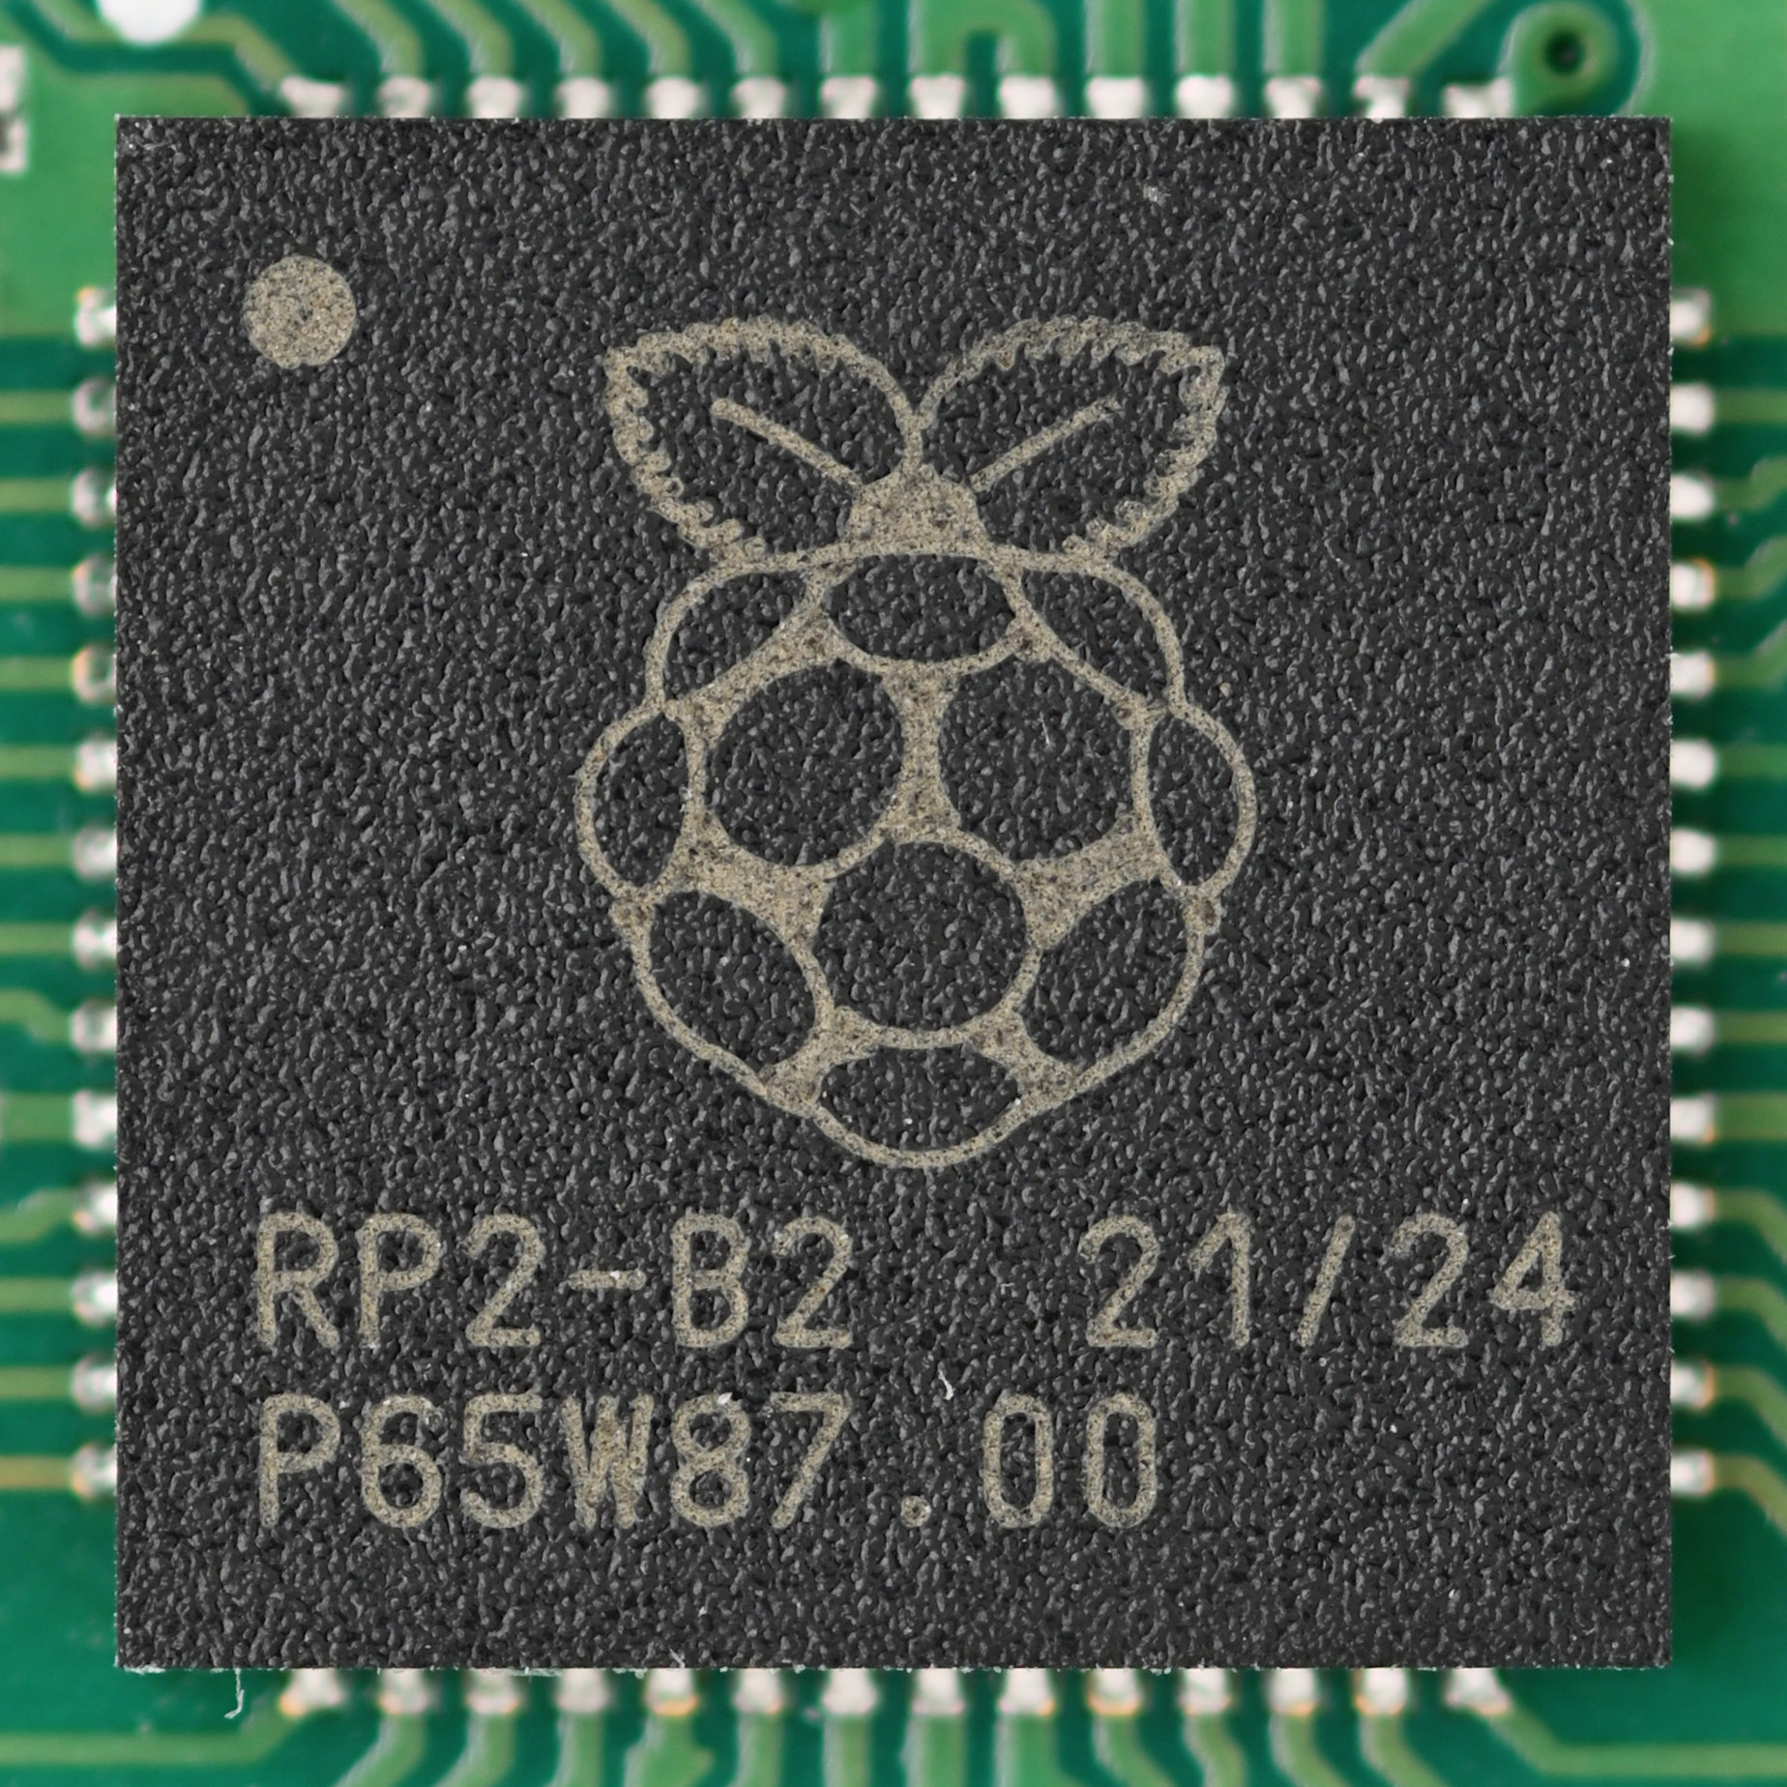
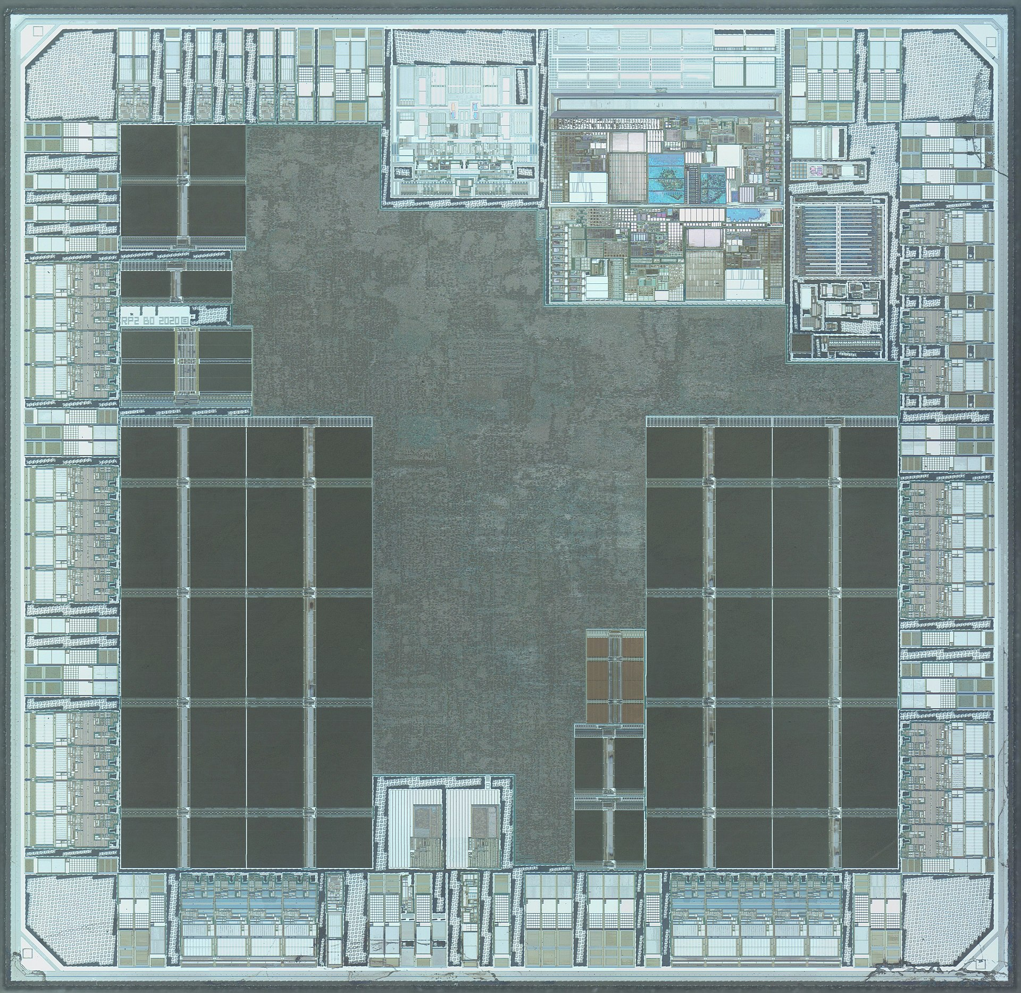
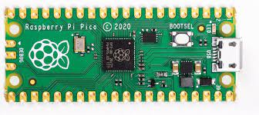
Raspberry Pi Pico: Multiple cores, Low-power

Slide 52
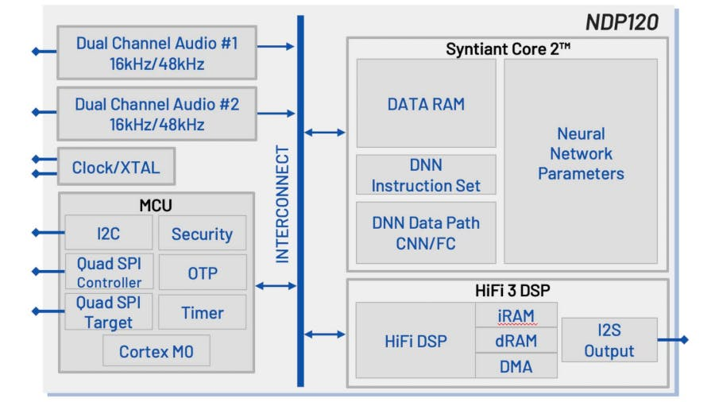
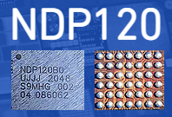
Microcontrollers with neural networks
Very low-power for specific tasks. Voice detection at hundreds of microwatts of power consumption

Slide 53
What are examples of microcontroller peripherals
Hardware modules that perform some action
Common examples
Control digital input and output pins
Read analog inputs
Send messages in a given wire protocol (UART, SPI, I2C)
Set and check timers
Less common examples
Cryptography accelerators
Complicated wire protocols (USB, CAN)
Wireless radios (BLE, 802.15.4, WiFi)

Slide 54
Processor design choices for embedded application
How many bits is the architecture?
8-bit and 16-bit not uncommon
64-bit is very rare (who has that much memory?)
What instructions are supported?
Normal stuff yes
What about single-cycle multiply?
What about floating-point operations?
Vector instructions?
How fast does it run?
1-100 MHz is common on modern systems (faster is more energy cost)
Occasionally MUCH slower (think 32 KHz)

Slide 55
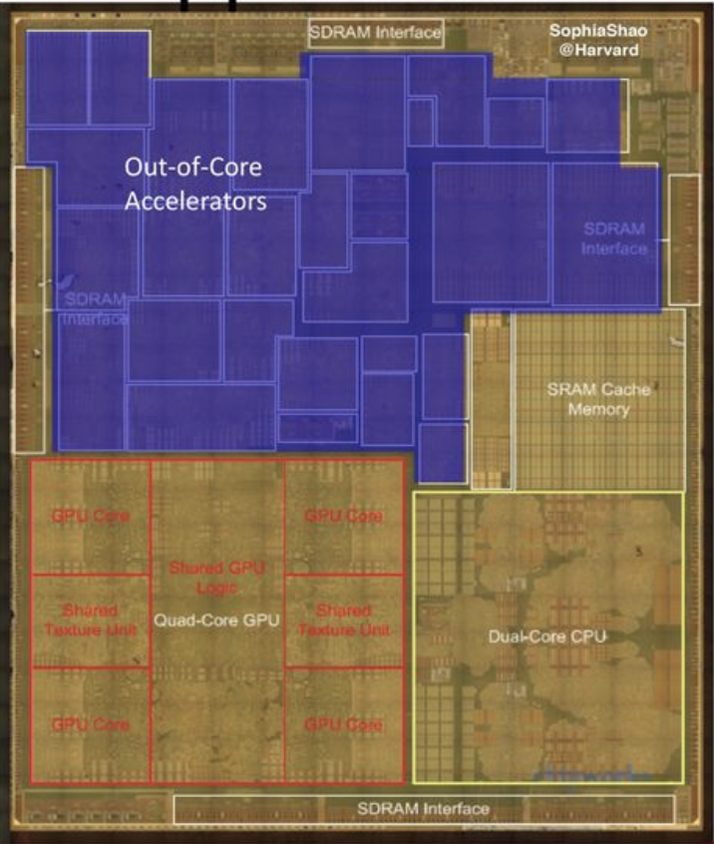
What are design choices for peripherals
More peripherals mean more use cases
But also means more cost for the chip
Peripherals occupy silicon
Most peripherals will go unused for a given application…
Flexibility within a given peripheral
One capability is easier to use
Many capabilities are more useful
Apple A8 SoC

Slide 56
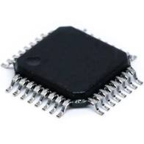
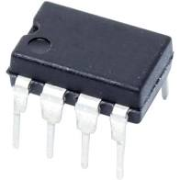
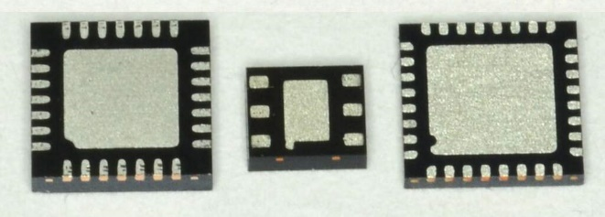

Connecting peripherals on microcontrollers
Peripherals need to electrically connect to outside world
Attach to pins on the exterior of the chip
More pins allow for more connections
At increased cost and size
Pin layouts can add more pins for cheaper
But make soldering and debugging difficult
Peripherals need to connect to external pins
Modern microcontrollers allow any-to-any connections

Slide 57
Roadmap of the lecture today
Let us recall what was covered in the last lecture
Microcontrollers
Storage
Bus: SPI and I2C
Example of library support in Arduino
Notes:
Here is the roadmap of the major topics that I am going to cover during the presentation. We have already covered the exponential growth of the internet of things; next, I will talk about the critical energy challenge that can severely hinder this massive growth and preventing us from realising this immense economic value enabled by the IoT.

Slide 58
Storage
Notes:
++ Over the past few years, I have designed several backscatter and beyond backscatter systems that precisely overcome these critical challenges that have limited the widespread deployment of backscatter on IoT devices.
++ The research vision that I have pursued and would like to pursue as a faculty member is to enable a massive deployment of IoT devices by bridging the energy asymmetry between sensing, computation and communication blocks by designing novel platforms and communication mechanisms. I am going to describe some of my research contributions next.

Slide 59
Memory on microcontroller (hierarchy)
Registers
RAM
ROM

Slide 60

Example of volatile memory: SRAM
Same design as registers in traditional computer systems
No need to refresh it -> lower energy costs
Tradeoff:
More expensive
Physically larger

Slide 61
Example of non-volatile memory: Flash
Same design as SSDs and Flash drives
Memory is stored with no energy costs
Reading is lowish energy and quick
Writing is high energy and very slow
Writing also has to occur in blocks (e.g. 512 bytes)
Concern: Flash has a limited lifetime ~10,000 writes
Only writing to Flash when you load code? Essentially forever
Recording data to Flash every second? 2.8 hours

Slide 62
SRAM (RAM) versus Flash (ROM)
Size and time difference between non-volatile and volatile memory is significantly reduced from traditional computing
Non-volatile store 2-10x larger than volatile
Single-cycle RAM. Maybe two-cycles to Flash (to read)
Major difference: energy and writability
SRAM is low-energy to read and write (no refresh needed)
Flash is lowish-energy to read, but very high energy to write
Hierarchical structure is not enforced
Same address space for RAM and Flash (very different from traditional)
Run instructions right inside of Flash
Keep variables in RAM (or const variables in Flash)

Slide 63
Emerging non-volatile memories FRAM , MRAM
FRAM and MRAM are both rising protentional Flash replacements
Non-volatile
Writable at the byte level
Very high to infinite write/erase cycles
Lower energy costs for writing and reading
The two-use unrelated magnetic techniques for data storage
Starting to appear in microcontrollers
TI MSP430s have used 16 kB FRAM
Apollo4 (ARM Cortex-M4F) has 2 MB of MRAM

Slide 64
How do you select microcontrollers?
Some of the metrics to be considered in making a selection:
Power consumption
Clock frequency
IO pins
Memory
Internal functions
Others? What else?

Slide 65
Roadmap of the lecture today
Let us recall what was covered in the last lecture
Microcontrollers
Storage
Bus: SPI and I2C
Example of library support in Arduino
Notes:
Here is the roadmap of the major topics that I am going to cover during the presentation. We have already covered the exponential growth of the internet of things; next, I will talk about the critical energy challenge that can severely hinder this massive growth and preventing us from realising this immense economic value enabled by the IoT.

Slide 66
Let us go back to Bus
Notes:
++ Over the past few years, I have designed several backscatter and beyond backscatter systems that precisely overcome these critical challenges that have limited the widespread deployment of backscatter on IoT devices.
++ The research vision that I have pursued and would like to pursue as a faculty member is to enable a massive deployment of IoT devices by bridging the energy asymmetry between sensing, computation and communication blocks by designing novel platforms and communication mechanisms. I am going to describe some of my research contributions next.

Slide 67
Synchronous communication with a single device
Device 1
Microcontroller
Device 2
Data Out Clock
Data In Clock
Device 3

Slide 68
Want bi-directional communication, so three wires
Device 1
Microcontroller
Device 2
Data Out Data In Clock
Data In Data Out Clock
Device 3

Slide 69
Wire signals to all devices to form a bus
Device 1
Data In Data Out Clock
Microcontroller
Device 2
Data Out Data In Clock
Data In Data Out Clock
Device 3
Data In Data Out Clock

Slide 70
Communicating on a bus
How do you distinguish which device you are talking to?
Address for each device
GPIO pin for each device

Slide 71
Communicating on a bus
How do you distinguish which device you are talking to?
Address for each device
Devices must always listen and then discard messages that aren’t for them
Need to define packet format so it’s clear where the address is
Need a method for addressing devices
GPIO pin for each device
Signal which device is being communicated with
Only activates communication on transition of “select” line

Slide 72
Separate chip select line for each device
Device 1
Data In Data Out Clock
Chip Select
Microcontroller
Device 2
Data Out Data In Clock
(2) Chip Select
Chip Select
(3) Chip Select
Data In Data Out Clock
Chip Select
Device 3
Data In Data Out Clock
Chip Select

Slide 73




Serial Peripheral Interface (SPI)
Device 1
Serial, synchronous, bus communication protocol
Single controller with multiple peripherals
Within a circuit board
High-speed communication
Multiple Mbps
Serial Data In Serial Data Out Serial Clock
$$\overline{\text{Chip} \text{Select} }$$
Microcontroller
Device 2
Serial Data Out Serial Data In Serial Clock
$$\overline{\text{Chip} \text{Select} }$$
$$\overline{\text{Chip} \text{Select} }$$
$$\overline{\text{Chip} \text{Select} }$$
Serial Data In Serial Data Out Serial Clock
$$\overline{\text{Chip} \text{Select} }$$
Device 3
Serial Data In Serial Data Out Serial Clock
$$\overline{\text{Chip} \text{Select} }$$

Slide 74


Timing and control information for the SPI bus
CS goes low to start transaction and high to end
Data is sent synchronously with clock signals
Capable of full-duplex transfers
Both directions at the same time
SCK
COPI
CIPO
$$\overline{\text{CS}}$$

Slide 75

Example of SPI communication
Transactions usually in multiples of bytes (as many as needed)
Bytes are sent LSB first
No need for framing bits (start/stop)
CS handles that

Slide 76

Different clock configurations for SPI
CPOL – is the clock default low or default high
CPHA – is data read on first edge or second edge
Peripherals tell you what their configuration is

Slide 77
What is the maximum data rate on SPI?
No particular requirements
Speed can go as fast as your clock and line capacitance can handle
Datasheet for devices will specify their speeds
Sort of standards (less so than UART, for example)
700 kbps
3.4 Mbps
10 Mbps

Slide 78

How do we determine when peripheral has information?
Controller starts/stops SPI transfers
Peripherals often add interrupt outputs to signal controller that an event has occurred

Slide 79
What are common use cases for SPI?
High-speed peripherals
Microphone, Accelerometer, External ADC
External memory
Memory chips
SD cards
All SD cards support a SPI communication mode
QSPI – Quad SPI (four COPI lines for more throughput)
Often used for communication with external memory

Slide 80
What are Pros and Cons for SPI?
Pros
Faster throughput (and no overhead)
No restrictions on data frame
No addressing requirements or word size assumptions
Full duplex transfers
Cons
Many pins: 3+N (for N peripherals)
CS line scales linearly (other signals are a bus)
Controller must initiate all transfers
Not designed for multi-controller scenarios

Slide 81

Inter-Integrated Circuit (I²C)
Two-wire, synchronous, bus communication
Ubiquitous in the embedded world
De-facto standard for sensors
Invented and patented by Phillips (now NXP)
Patent expired in 2004
Also known as Two-Wire Interface (TWI)

Slide 82

An overview of Inter-Integrated Circuit (I²C)
SDA – Serial Data
SCL – Serial Clock
Usually 100 kHz or 400 kHz
Communication is a shared bus between all controller(s) and peripheral(s)

Slide 83

I2C transactions
Default
Both lines float high (pull-up resistor)
Start condition
Drive SDA low while SCL is still high

Slide 84
I2C transactions
First byte is chip address + R/W indication
Address: 7-bit value that needs to be different for each participant
R/W: 1 for read, 0 for write
Values are sent MSb first (reverse of other protocols )

Slide 85
I2C transactions
Acknowledgement from peripheral follows each byte
Controller lets line float high
Peripheral drives line low to signal receipt of message

Slide 86
I2C transactions
Data frame(s) follow
Sent as entire bytes, plus and ACK
As many as needed before Stop condition
Stop condition
SDA goes high while SCL is high (normally data only changes when clock is low)

Slide 87

Real-world I2C transactions

Slide 88

Each I2C device on a bus must have a different address
Shared addresses would cause both to respond
ICs often have one or more address pin(s) used to select bit(s) of address
0 pins: only one may be on bus
1 pin: two may be on bus
2 pins: four may be on bus
If no address pins (or not enough), need an I2C address translator chip
A0 is low: address 1001010x
A0 is high: address 1001011x

Slide 89

Sparkfun Qwiic connect system
System for wiring multiple prototyping boards together
Four-pin connector
VCC (3.3 volts)
Ground
SDA
SCL
Daisy-chains through boards
Actually connects to chips in parallel as a bus
https://www.sparkfun.com/qwiic

Slide 90
I2C use cases
Various sensors
Usually low to medium speed
Even relatively high speed stuff often has I2C for convenience
Accelerometers and microphones
Often with intelligent filtering built in
Communication between microcontrollers
Either can act as the Controller when necessary
Commonly exists internally within smartphones and laptops too
Light sensors, Temperature sensors, etc.

Slide 91
I2C Pros and Cons
Pros
Wiring is simple
Only uses two pins
Very widely supported
Cons
Relatively slow communication rate
Speed versus power use tradeoff (due to pull-down resistor)
Open collector makes debugging difficult

Slide 92
Roadmap of the lecture today
Let us recall what was covered in the last lecture
Microcontrollers
Storage
Bus: SPI and I2C
Example of library support in Arduino
Notes:
Here is the roadmap of the major topics that I am going to cover during the presentation. We have already covered the exponential growth of the internet of things; next, I will talk about the critical energy challenge that can severely hinder this massive growth and preventing us from realising this immense economic value enabled by the IoT.

Slide 93
Embedded Software Programming
Ambuj Varshney
ambujv@nus.edu.sg
Notes:
++ Thank you for inviting me to give this talk
++ In this talk, I will present a pathway that can enable us to make wireless embedded systems ubiquitous. I will describe my previous research efforts that tackle the critical challenges that limit the growth of wireless embedded systems. These are related to the growing energy asymmetry that exists between sensing, computation and communication blocks on these platforms.
++ Finally, I will conclude my talk by covering the research agenda that I would like to work on as a faculty member.

